Slide 1


How HQIP intends to maximise transparency and use of audit data for regulation
Dr. Kieran Mullan
Clinical Audit for Improvement Clinical Lead
Promoting improvement in the quality of health and social care

Slide 2
Clinical Outcomes Publication (COP) programme
National Clinical Audit Benchmarking (NCAB) programme
Promoting improvement in the quality of health and social care

Slide 3



Intelligent Transparency
“Comprehensive transparency of performance data – including the results of treatment and what patients and carers say – to help health professionals see how they are performing compared to others”
Promoting improvement in the quality of health and social care

Slide 4

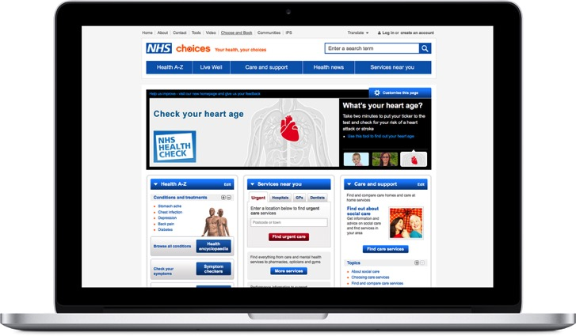
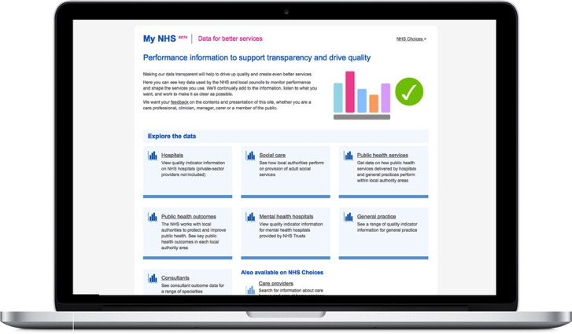

Consultant Outcomes Publication
NHS Choices (www.nhs.uk)
MyNHS (www.nhs.uk/mynhs)
Comprehensive general health and social care information and data about conditions, treatments and services
Aimed at those with direct or indirect health or care needs in England
Vision to transform NHS Choices
A single place where health and care organisations and the public can compare the performance of services
Aimed at informed patients and service users, providers, commissioners
Led by Department of Health and partners
Improvements to design and functionality this year

Slide 5
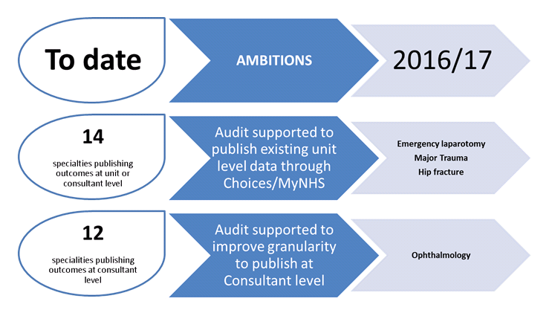
Timeline

Slide 6
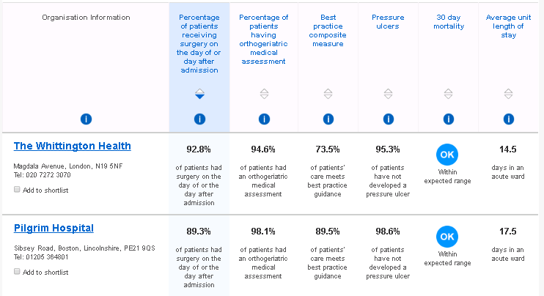
Team level-Hip Fracture

Slide 7
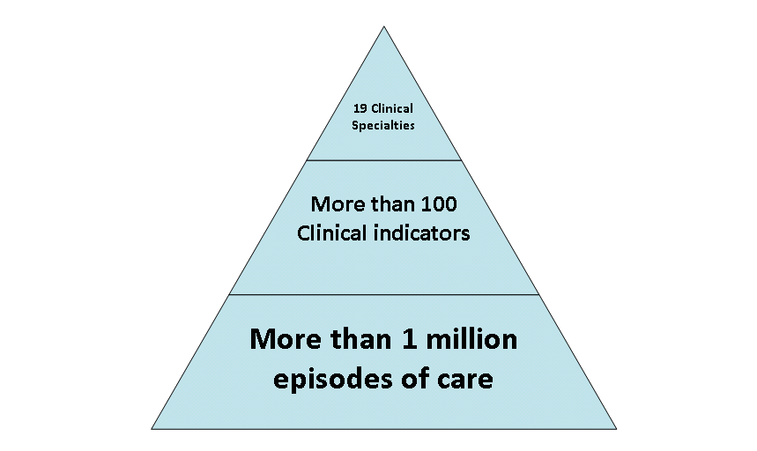
Scope of the Outcomes 16/17

Slide 8
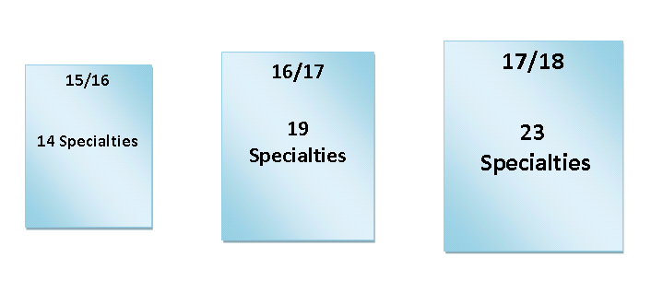
Plans for 17/18
Promoting improvement in the quality of health and social care

Slide 9
Plans for 17/18
Project management from your NCAPOP team
Agreeing timelines and managing the different deliverables
Pressure on available slots is increased as the programme expands
Revalidation and appraisal
Promoting improvement in the quality of health and social care

Slide 10
Beyond 17/18
Website changes
Varying MyNHS and NHS Choices display
Outline of audits due to join completed internally
If you haven’t been approached and think you are ready to go, let us know
Promoting improvement in the quality of health and social care

Slide 11
A new HQIP acronym is born!
NCAB
National Clinical Audit Benchmarking
Promoting improvement in the quality of health and social care

Slide 12
Aim
To optimise the use of National Clinical Audit data for Quality Improvement by
Providing audit data* in an easily available format to Medical Directors, Clinical Directors and Clinical Governance Leads
Facilitating Benchmarking
Downloadable content
Aligning with the CQC to create a shared vision of quality
*Audits have provided up to 6 main outcomes which have been displayed in an accessible form.
Promoting improvement in the quality of health and social care

Slide 13
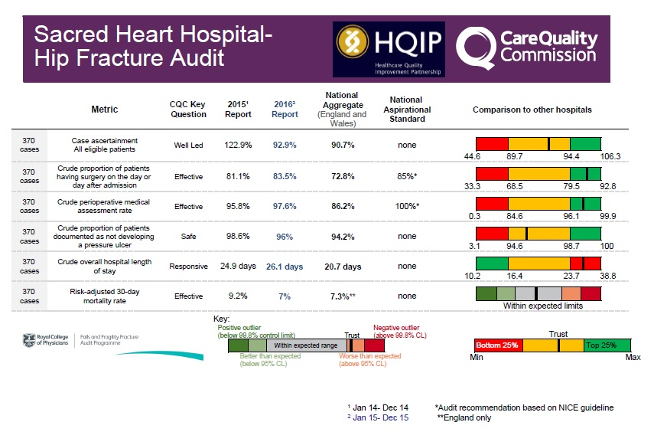

Slide 14
Pilot
Data sharing slides for 5 audits in the Manchester region.
Data from National Hip Fracture, National Vascular Registry, the Oesophageal Cancer audit, Bowel Cancer audit and the Intensive Care Case Mix Programme were used.
Eight Trusts took part
The response was overwhelmingly positive, some Medical Directors commenting that it had been the first time some of them had seen this data.
Promoting improvement in the quality of health and social care

Slide 15
Audits Involved (subject to change)
1st Tranche
National Hip Fracture Database
National Vascular Registry
National Bowel Cancer Audit
National Lung Cancer Audit
Oesophago-gastric Cancer Audit
Intensive Care National Audit and Research Centre
National Care of the Dying Audit
3rd Tranche
Epilepsy12
Ophthalmology
National Audit of Rheumatoid and Early Inflammatory Arthritis
National Audit of Inpatient Diabetes
National Audit of Diabetes Footcare
National Audit of Diabetes in Pregnancy
Chronic Obstructive Pulmonary Disease
National Audit of Dementia
Cardiac Rhythm Management
Congenital Heart Disease
Adult Cardiac Surgery
Inflammatory Bowel Disease (adult)
Inflammatory Bowel Disease (paediatrics)
National Joint Registry
2nd Tranche
Sentinel Stroke National Audit Programme
Adult Percutaneous Interventions (BCIS)
National Emergency Laparotomy Audit
National Audit of Inpatient Falls
Mothers and Babies: Reducing Risk through Audit and Confidential Enquiry
Heart Failure Audit
National Neontal Audit
Trauma Audit and Research Centre
Paediatric Intensive Care Network
Myocardial Ischaemia National Audit Project
National Paediatric Diabetes Audit

Slide 16
NCAB website
Data to sit on HQIP website with a dashboard for easy access to individual Trust results
Promoting improvement in the quality of health and social care

Slide 17
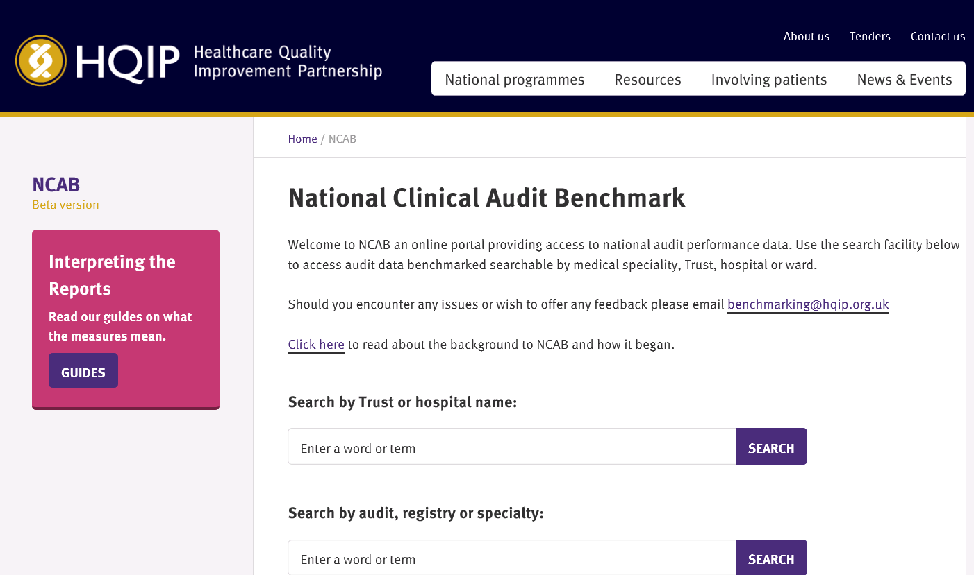

Slide 18
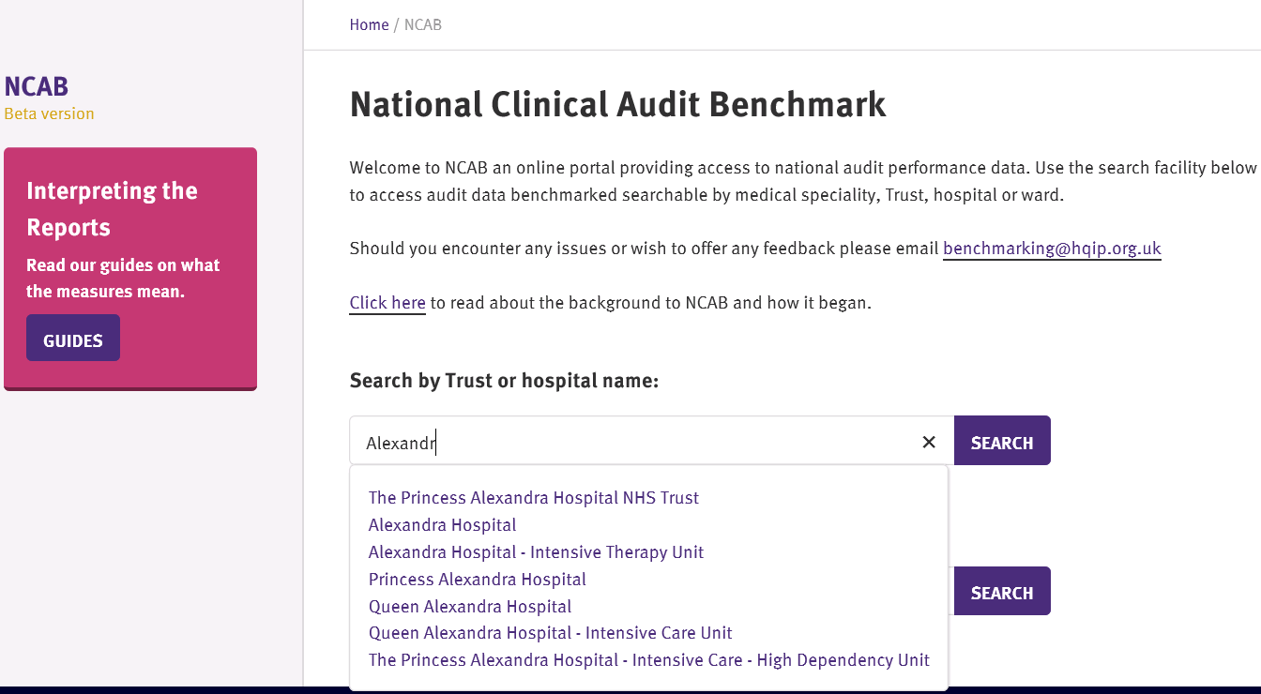

Slide 19
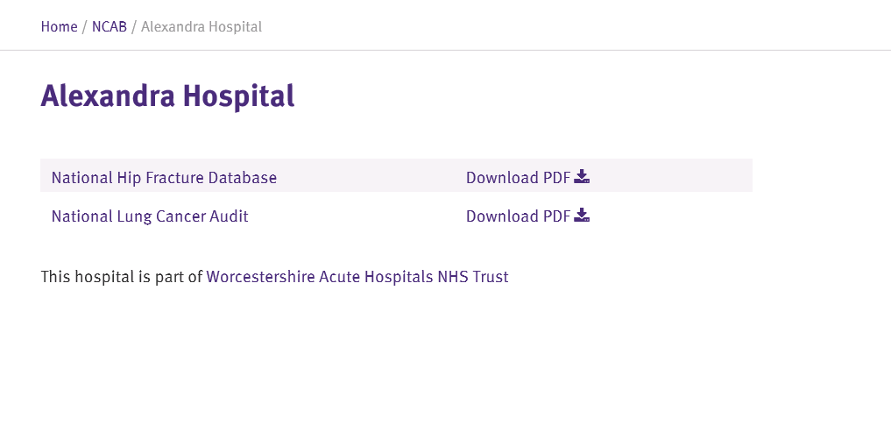

Slide 21
Launch plan
Test site shared with the SG-DONE
Test site shared with Trust Medical Directors and CEOs and Bruce Keogh-DONE
Promoting improvement in the quality of health and social care

Slide 22
“These are great and will be really useful.”
“I am pleased to discover that I am already very familiar with all of the reports logged for our trust, but it is helpful to see them collected in one place, where I can check that none have slipped through the net. “
“It is an excellent idea that I can get access to them in one easy site. “

Slide 23
Launch plan
Test site shared with the SG-DONE
Test site shared with Trust Medical Directors and CEOs and Bruce Keogh-DONE
Review feedback-May/June
Launch of beta site-Currently planned for July
Promoting improvement in the quality of health and social care

Slide 24
Collaboration with You
CQC will continue to lead on slide production
HQIP will facilitate this through contract review meetings and also provide ad hoc support
Promoting improvement in the quality of health and social care

Slide 25
COP and NCAB
NCAB-targeted activity to specific audiences
Metrics - will continue to align them wherever possible
Project management – unified approach to support you as providers
Data supply – we are aware of the burden!
Promoting improvement in the quality of health and social care

Slide 26
Questions?
Promoting improvement in the quality of health and social care

